Slide 1

K. S. R. College of Engineering (Autonomous) Affiliated to Anna University, Chennai & Approved by AICTE, Delhi Accredited by NAAC with ‘A’ Grade and Accredited by NBA K.S.R. Kalvi Nagar, Tiruchengode – 637215, Namakkal Dt. Tamilnadu.
B. E. - Computer Science and Engineering
Project Title
Vista via vibrations
Deepika.E(1813013)
*
1

Slide 2
ABSTRACT
The main objective of developing “VISTA VIA VIBERATIONS” is
to help the visually impaired to actually interact with the environment .The device will integrate a camera to view the
users environment and implement machine learning to
interpret this data as a collection of objects.It will also utilize a novel directional haptic feedback system,enabling interactions with objects.
*
2

Slide 3
Existing System and its disadvantage
An extensive review of existing solutions was conducted ,and a selection of which is presented here:
1.The KNFB Reader : It is a text reader application for the blind. The user utilize a mobile device to take a picture of a document or other text source, and the app subsequently converts that text into speech or Braille[knfbreader.com/the-app.]
Limitations:
Since this technology is only available in app form, a blind user must continuously hold their device out in front of them an awkward pose to maintain for long periods of time
2. LookTel Money Reader : Itis a service that calculates the amount of currency presents in an image of paper money.
[www.looktel.com /moneyreader.]
Limitations : Inability to handle anything other than currency.
*
3

Slide 4
Objective of Proposed System
The Raspberry Pi waits for a wake command form the user. This can come from either
saying the wakeword “Hey George” into the microphone of an Android phone running
our applications, or by placing a finger on the easy-to-find divot in the casing of the device . The user then verbalizes their command into the phone’s microphone, or long-presses the capacitive touch sensor to trigger a default scan of the environment.
This command is sent to the server to be relayed to the Raspberry Pi.
Once the Raspberry Pi receives the command from the server, it begins to execute the required action. First, the Raspberry Pi captures an image from the camera and converts
it into a base64 string to be sent back to the server which is sent back to the server which is sent to the user’s phone.The TensorFlow models is runned onto the user’s phone instead of relying on expensive cloud computing services. The user’s phone loads a TensorFlow instance to describe the sense or pinpoint a specific object.
*
4

Slide 5
Advantages of Proposed System
1.NIGHTVISION: By utilizing a special camera module without an InfraRed (IR) filter and then utilizing IR LEDs to shine on the camera’s target, we grant the blind
night vision.
2.DEPTH PERCEPTION: The device is able to determine exactly how far away the desired target object is through stereoscopy. This will help to more carefully direct the blind user’s hand towards the target, and avoid collision.
3.SPECIAL CAMERA SETUP: Through upgraded SainSmart camera, however, the Raspberry Pi is able to track objects with a 160-degree FOV.This allows the user to point “VISTA VIA VIBERATIONS” towards a cluttered table and be able to scan the entire desk at once, making device much easier to use.
4.GESTURE CONTROL: Since voice input is not always possible in extremely loud or quiet surroundings,electromyography (EMG) sensors are used to provide an alternative input method for users.
*
5

Slide 6
Modules Description
HARDWARE REQUIREMENTS:
Raspberry Pi3:
The Raspberry Pi 3 model B is a tiny credit card size computer. Just add a keyboard, mouse, display, power supply, micro SD card with installed Linux Distribution and you’ll have a fully fledged computer that can run applications from word processors and spreadsheets to games.
Camera Setup:
The camera module is a custom designed easy plug and play for Raspberry Pi. It attaches to Raspberry Pi by way of one of the two small sockets on the board upper surface. This bus travels along the ribbon cable that attaches the camera board to the Pi. The sensor itself has a native resolution of 5 megapixel.
NIGHT VISION CAMERA:
Camera with removed IR filter allows usage at night also(with IR lighting)
*
6

Slide 7
SOFTWARE REQUIREMENTS:
Open CV:
OpenCV is a cross-platform library using which we can develop real-time computer VISTA applications. It mainly focuses on image processing, video capture and analysis including features like face detection and object detection.
Raspberry Pi Raspbian:
Raspbian an official operating system for all models of the Raspberry Pi.
Amazon web service AWS:
It is a secure cloud services platform, offering compute power, database storage, content delivery and other functionality to help businesses scale and grow.

Slide 8
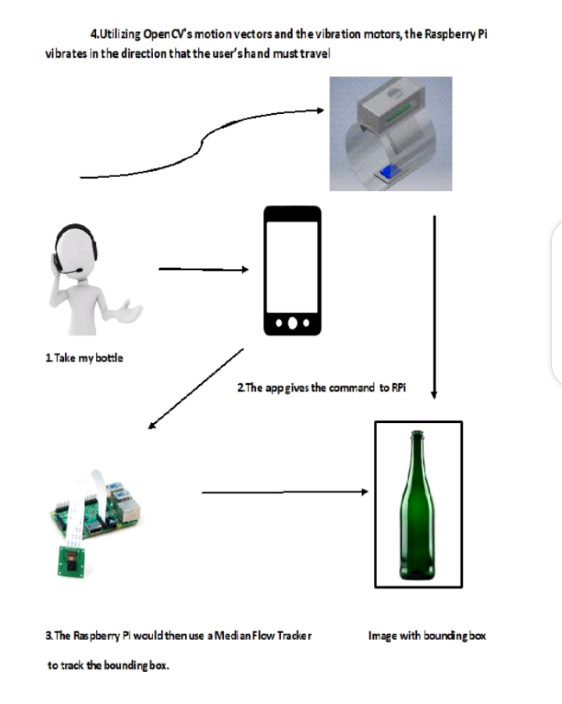
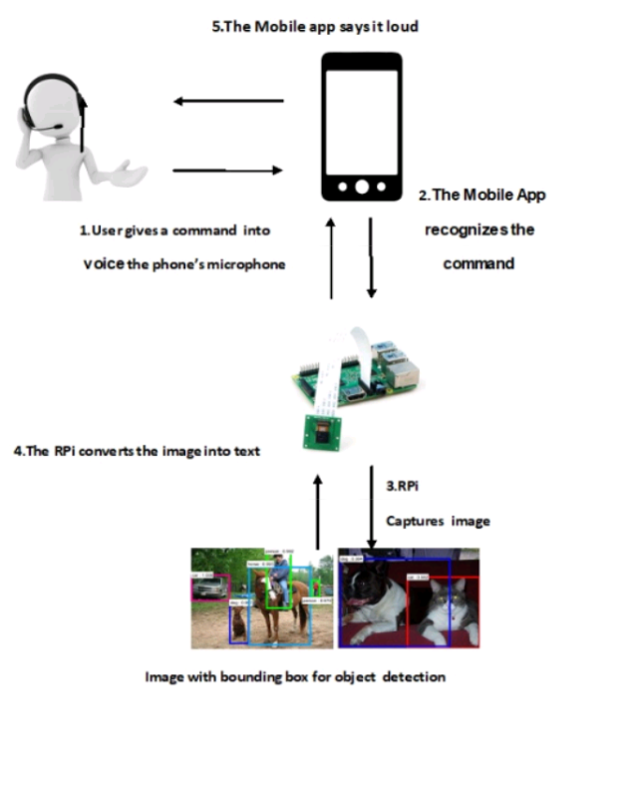
System Architecture / Module diagram
*
8

Slide 9
References
1.Kurzwell, Ray.”WHAT CAN KNFB Reader Do for You?” About KNFB Reader | KNFB Reader, KNFB Reader, knfbreader.com/the-app.
2.Soon-shiong, Patrick. “LookTel Products.” LookTel Money Reader, LookTel, www.looktrl.com/moneyreader.
3.”TapTapSee” - Blind and visually impaired Assistive
Technology - powder by cloudsight.ai Image recognition API, MIT,taptapseeapp.com/.
4.”BlindSight”- virtual eyes through Haptic FeedbackDeveloped by Devin Mui, JaiveerSingh, Jaimiejin, Jesse Liang www.hackster.io/team-blind
*
9

Slide 10
Queries?
*
10

Slide 11
THANK YOU
*
11

